Slide 1
PLANT CARE WEBSITE
Oxyzen
A Smart Way to Take Care of Your Plants

Slide 2
TABLE OF CONTENTS
01
02
INTRODUCTION
PLANNING
03
04
TOOLS
FUTURE PLANNING
Plant care!

Slide 3
WHAT OUR WEBSITE OFFERS

Slide 4

Introduction
In today’s fast-paced life, we often forget small but important tasks, like watering a plant, giving it the right amount of light, or even fertilizing it on time. And sometimes, even if we remember, we may not always know what a specific plant really needs, or how to take care of it if it shows signs of illness.
This project aims to make plant care both informative and emotionally fulfilling.

Slide 5
Through this website, users can:
Understand what the platform offers right from the homepage.
Log in to access personalized features like plant care guides, plant disease info, reminders, and more.
Explore various plants and learn how to care for them.
Identify plant diseases, know their symptoms, treatments, and precautions.
Set reminders for watering, fertilizing, and light exposure.
And most uniquely, write their own plant journals – to record special moments like the plant’s first bloom or growth progress.

Slide 6
IDEAS BEHIND THE PROJECT
Many people love plants but struggle to take care of them regularly.
Sometimes they forget when they last watered them, or don’t know what a plant needs to stay healthy.
And when a plant gets sick, they don’t know what’s wrong or how to fix it.
So why not make a website that helps with all of this in one place?
Planning

Slide 7
WHAT THIS WEBSITE DOES
Planning
Educates users about different plants and their needs
Reminders for regular care
Offers a personal plant journal feature for memories
Know how to identify and treat diseases

Slide 8
HOME PAGE & LOGIN SYSTEM
REMINDERS & PLANT JOURNAL
FEATURES OF OXYZEN
PLANT CATALOG & DISEASE INFO
Gives a quick overview of what the website does and personalized experience after login.
Create reminders for watering, fertilizing and lighting. Users can write journal entries also.
Plant care!
Explore various plants with images and detailed care guides. User can learn about plant diseases, symptoms, treatments and precautions.

Slide 9
TOOLS
Frontend:
React JS: For interactive and dynamic UI
Tailwind CSS: For fast and elegant styling
React Router: For page navigation
React Toastify: For smooth user notifications
Backend:
Node.js & Express.js: For backend logic
MongoDB: To store user data, plant info, journals and reminders.

Slide 10
FURTHER IMPLEMETATIONS
AI Plant Health Assistant: Upload a plant photo and get disease detection
Community Feature: Connect with other plant lovers to share tips and posts
Image Upload for Journals: Share photos of their plant’s growth
Email or Mobile Notifications: Get automatic care alerts

Slide 11

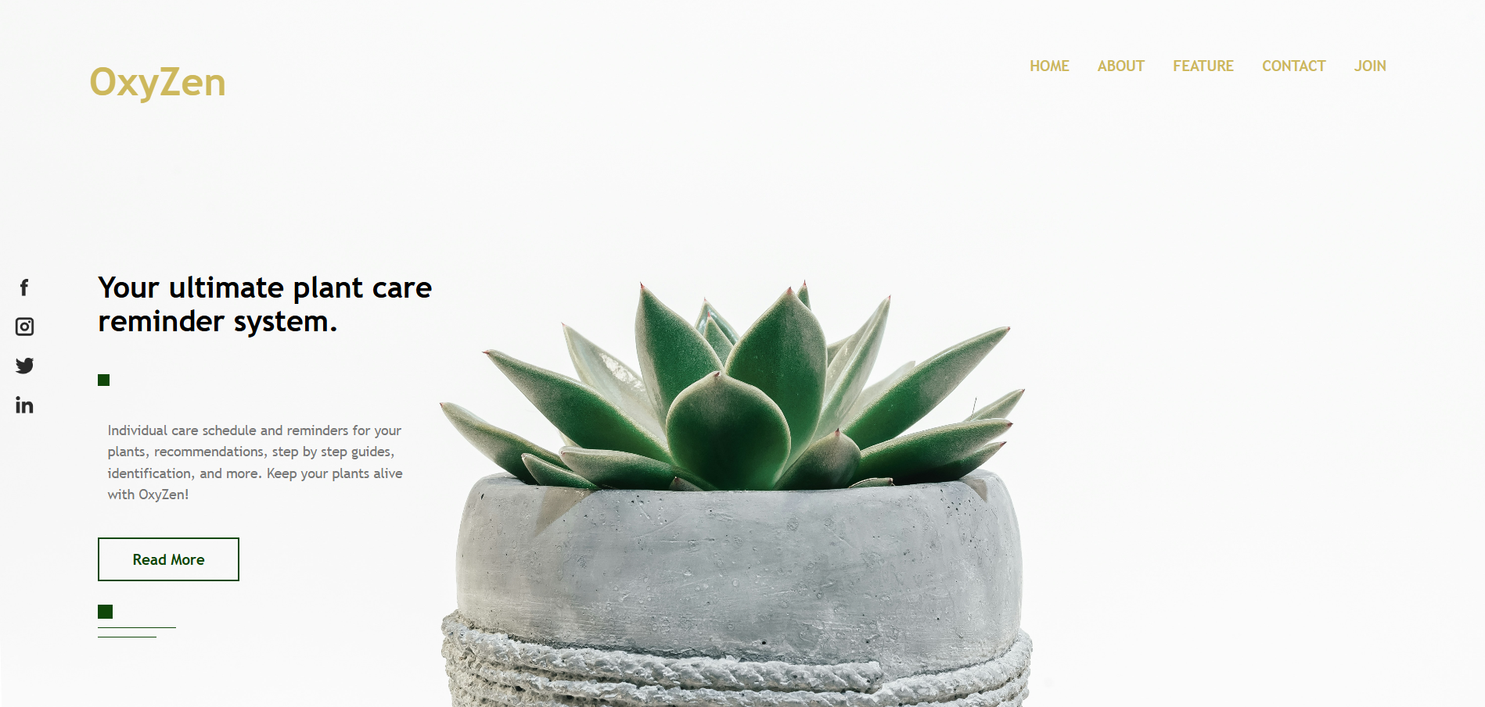
VISIT OUR WEBSITE
Find us here!
Visit our website and Keep your plants alive!

Slide 12
THANK
you!
Name: Ummey Rukaiya
Roll No: 2203088
Section: B
https://github.com/Ummey-Rukaiya/OxyZen_WebProject

